Slide 1



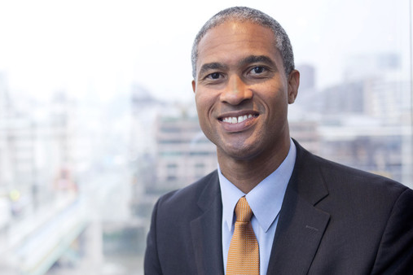






LIVE BROADCAST
2nd
CARIBBEAN ECONOMIC FORUM
Featuring
Dr. Peter Blair Henry
Jamaican-Born Economics Scholar
and
Dean, New York University’s Leonard N. Stern School of Business

Slide 2
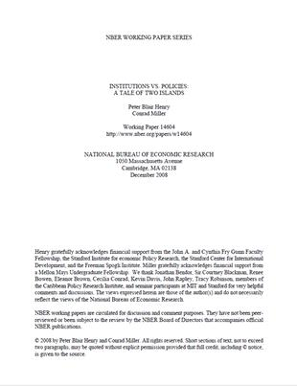

Author of
Turn Around: Third World Lessons for First World Growth and Institutions VS Policies: A Tale of Two Islands
Read Excerpt

Slide 3
The Central Bank of Barbados invites the employees, members and associates of CARICOM to tune into a live broadcast of the second Caribbean Economic Forum on March 19, 2015 at 8:00 p.m. AST, 7:00 p.m. EST
In this broadcast, Distinguished Visiting Fellow, Dr. Peter Blair Henry, who’s on a short sabbatical at the Barbados-based Bank, will interact with veteran regional broadcaster, Julian Rogers.

Slide 4
Dr. Henry is considered a superb and highly productive economics scholar, a natural leader, a community builder, and a manifestly good person.

Slide 5
Discussion topics include:
The impact of economic reform on the lives of people in developing countries
The importance of economic policy to economic growth
What role finance plays in helping us figure out how to allocate capital efficiently around the world
Pragmatic Leadership
His advocacy for a greater emerging market voice in the International Monetary Fund
And what he believes are the three (3) key ingredients in a country’s economic success: discipline—a sustained commitment to a pragmatic growth strategy that is vigilant, flexible, and values what is good for the country as a whole over what’s good for any individual or interest group; clarity—a clear commitment by the country’s leaders to a change of direction; and trust—between citizens and their government, for example, or between two countries

Slide 6
The benefits to your staff, members and associates are plenty. They include:
Interacting with a distinguished University Leader, outstanding scholar and pragmatist
Understanding the issues that should shape economic thought, planning and policy in the Caribbean; and
Hearing from someone who understands and thinks a lot about developing countries.
Log onto www.centralbank.org.bb
CARICOM’s staff, members and associates may participate by sending their questions to questions@centralbank.org.bb or by calling +1 (246) 227- 8302

Slide 7

SPONSORS

